Slide 1

Web Devoloper in Prodigy
Presented by:
Maheshwar rao Valuvajjala
Computer Science and Engineering
Enrollment Number: 21CS002430
Supervisor: Mr. Shivam Upadhyay

Slide 2
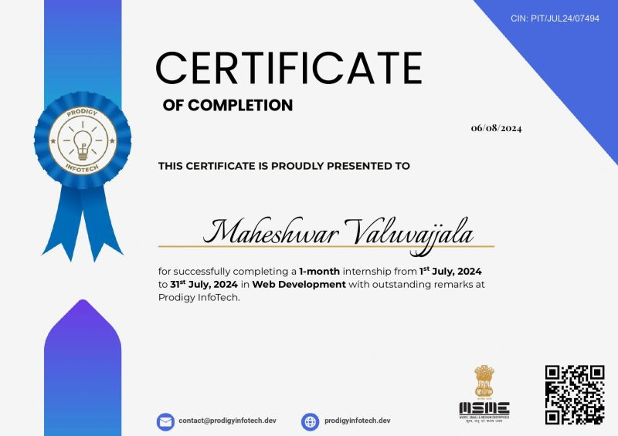
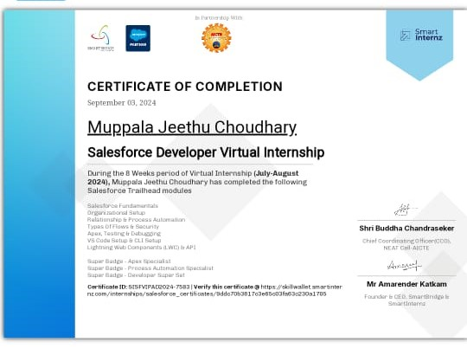
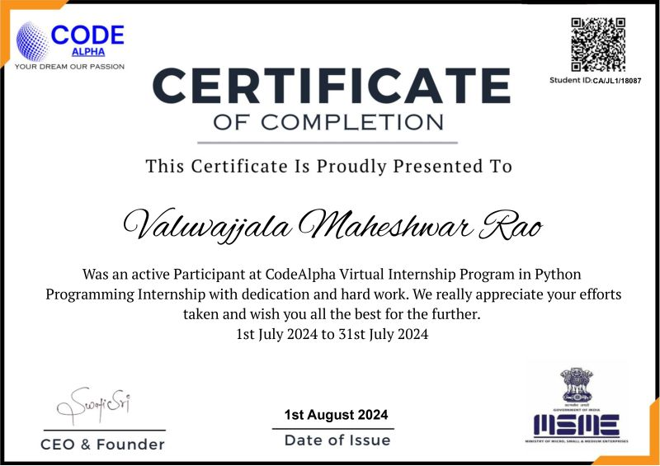
Internship Certificate

Slide 3
Introduction
Company Name : prodigy
Brief Description : Prodigy specializes in web development tools, enhancing programming efficiency and performance.“
Overview of the Internship Program : Interned at Prodigy focusing on web development projects. Importance of the Internship: Acquired practical web development experience and industry knowledge.

Slide 4
Internship Objectives
Duration: 1 Month (July 10th - August 31st )
Location: Remote
Internship Type: Part-time
Company's Expectations: Deliver functional web features, adhere to deadlines, and innovate.
Internship Objective : Develop and enhance web applications to improve user experience.

Slide 5
Key Project & Responsibilities
Project Title: Web Development Projects.
Brief description : creating web development project websites
Your role and contributions : Designed, coded, and tested web features; collaborated on improvements.
Technologies/Tools used : HTML, CSS, JavaScript, web development, debugging, and teamwork.

Slide 6
Project Description
Project Description: Created and optimized interactive web applications for better performance..
Focus on impact : Improved user engagement, application functionality, and team efficiency..
Key Achievements/Outcomes: Completed projects on time, enhanced web functionalities, received positive feedback.
Visuals:

Slide 7
Lessons Learned
Key Takeaways:
- Applied web development skills in real-world scenarios; teamwork experience
Challenges Overcome: Overcame debugging issues, adapted to project requirements, and tight deadlines

Slide 8
Conclusion and Results
Gained significant web development experience and made valuable contributions

Slide 9
Future Work
Next Steps:
Continue advancing web development skills and exploring new technologies.
User Feedback Integration: Incorporated feedback to refine features and improve user experience.

Slide 10
Mentor Contact Information
Mentor Name: Mr. Shivam Upadhyay
Email : info@thesmartbridge.com

